Slide 1
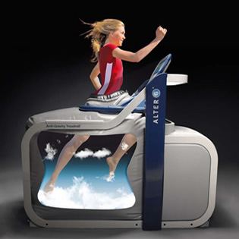
Running on a Cloud
Alter-G Antigravity Treadmill
Kendall Dorsey
ITS 1015-112913

Slide 2
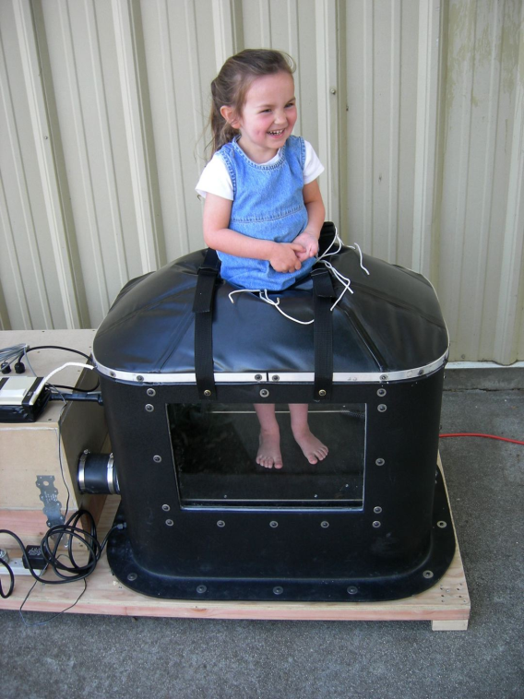
Problems in Physical Rehabilitation Post Injury.
Patients return to daily activities to soon (Mainly kids 12-18)
Rehab for most injuries takes 6-9 months
Business/sports teams lose time and money
Advanced Technology is very expensive

Slide 3
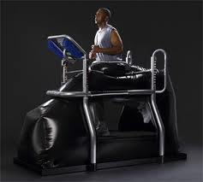
Alter-G Providing Solutions
Reduces gravity in increments between 20%-100%
Provides a safe way for intensive work out
Improves strength, and mobility
Trains without stress and pain to joints and tissue

Slide 4
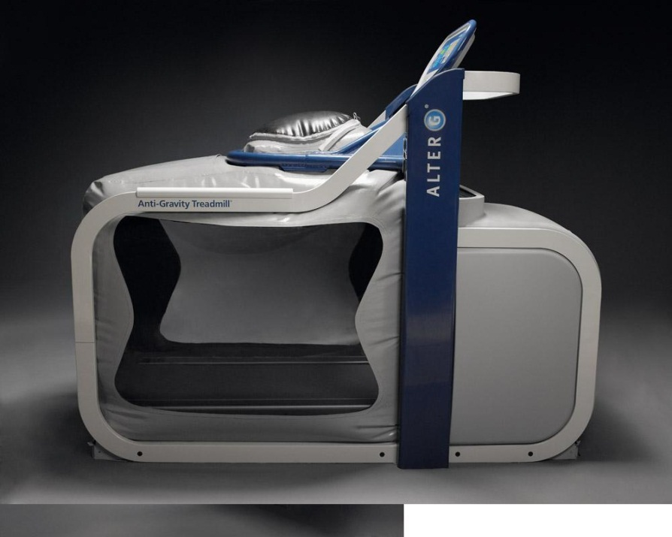
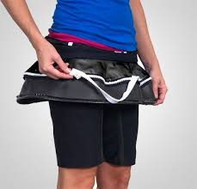
Feature of The Alter-G
Quick and easy, zip spandex shorts in airtight bubble, set weight and go
Efficient way to run and maintain stability
Very secure while exercising within machine
Great work out in only 15 min

Slide 5
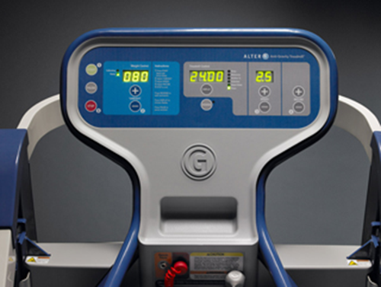
Alter-G Tech Specs.
Hardware.
Software Network
NASA Air Pressure Controller
Alter-G Treadmill
Weight, Motion etc Sensors
Interactive Screen Monitor.
IBM PC
Alter-G Software
Windows
Wireless Network
Switch
Router

Slide 6
Summary
Alter-G Treadmill is a new improved technology to reduce recovery time
Provides a safer work out method
Improves Strength and Mobility
Trains with less stress

Slide 7
Works Cited
FISIOELITE Therapies for Motor Rehabilitation. FISIOELITE Inc. 11 March 2014. http://www.fisioelite.it/eng/treadmill_antigravitazionale.php
Alter G. 2014 Alter G, Inc. 11 March 2014. http://www.alterg.com/products/anti-gravity-treadmills/m320-f320/health-wellness\
Alter G. 2014 Alter G, Inc. 11 March 2014. http://www.alterg.com/
Finish Line Physical Therapy. Finish Line. 11 March 2014. http://finishlinept.com/services/alterg-anti-gravity-treadmill/
Alter G. 2014 Alter G, Inc. 11 March 2014. http://www.alterg.com/who-we-are

Slide 8
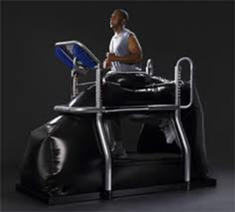
Picture References
FISIOELITE Therapies for Motor Rehabilitation. FISIOELITE Inc. 11 March 2014. http://www.fisioelite.it/eng/treadmill_antigravitazionale.php
The Muscle Clinic. Muscle Clinic Inv. 11 March 2014. <http://www.themuscleclinic.ie/>
Alter G. 2014 Alter G, Inc. 11 March 2014. http://www.alterg.com/products/anti-gravity-treadmills/m320-f320/health-wellness\
Examiner. 2006-2014 Clarity Digital Group. 11 March 2014. http://www.examiner.com/article/can-runners-train-through-pain-with-the-alterg-anti-gravity-treadmill-video

Slide 9
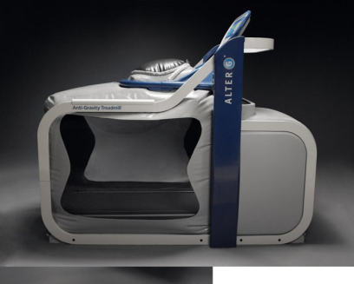
Pic References Continued…
Egan Gans. Egan D Gans. 11 March 2014. http://egangans.wordpress.com/page/2/
Alter G. 2014 Alter G, Inc. 11 March 2014. http://www.crunchbase.com/company/alter-g

